Slide 1

CAREER VILLAGE
DSBA - 6211 Project Presentation
Carson Groulx
Naomi Thammadi
Saurabh Vijay
Shina Dhingra
Will Patten

Slide 2

INTRODUCTION
Community where Professionals help Students by answering questions
Students and Professionals are spread across the world
Students tag questions and Professionals subscribed to the tags get notified via email
Questions and Answers are scored

Slide 3


Slide 4
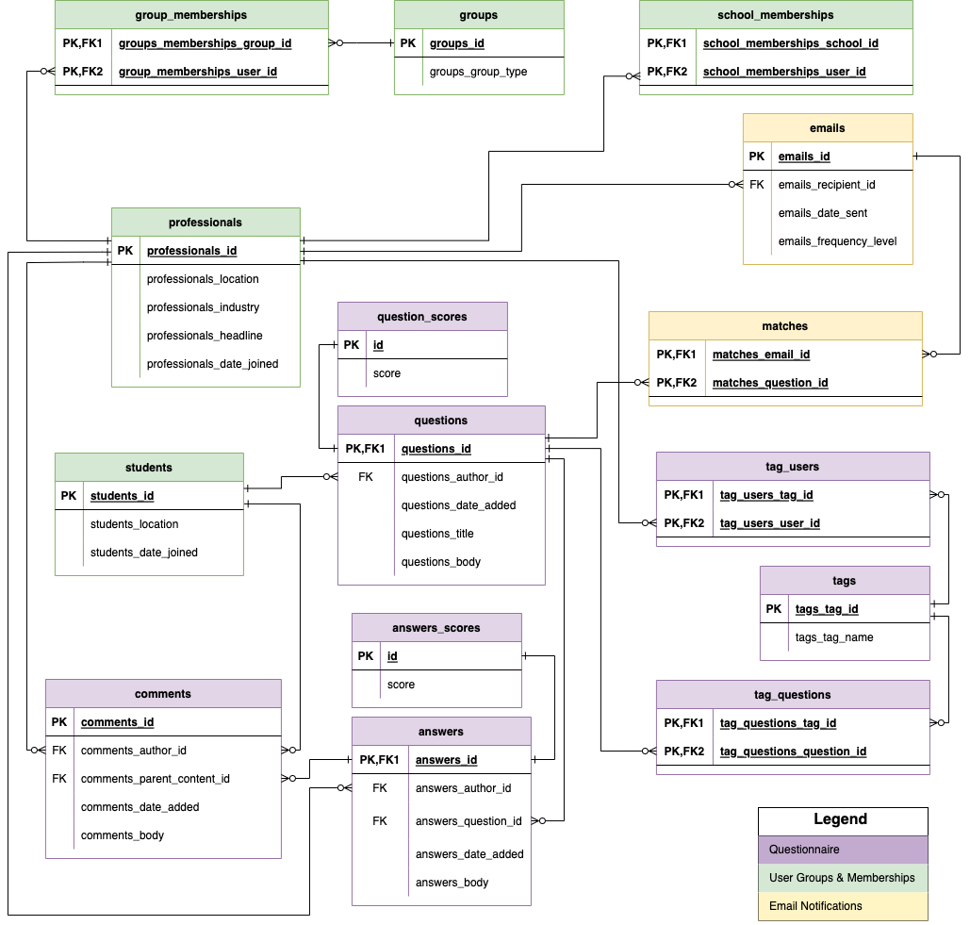
DATA
MODEL

Slide 5
DATA PRE-PROCESSING
TAGS
SCORES
01
02
PROFESSIONALS
EMAILS
03
04
Combined tags on questions & professionals and summed their counts
Merged scores for questions and answers
Grouping of Industry and extracting Company from headline
Notification counts on immediate, daily and weekly bases

Slide 6
EXPLORATORY DATA ANALYSIS
TOOLS USED:
Tableau
R
Python

Slide 7
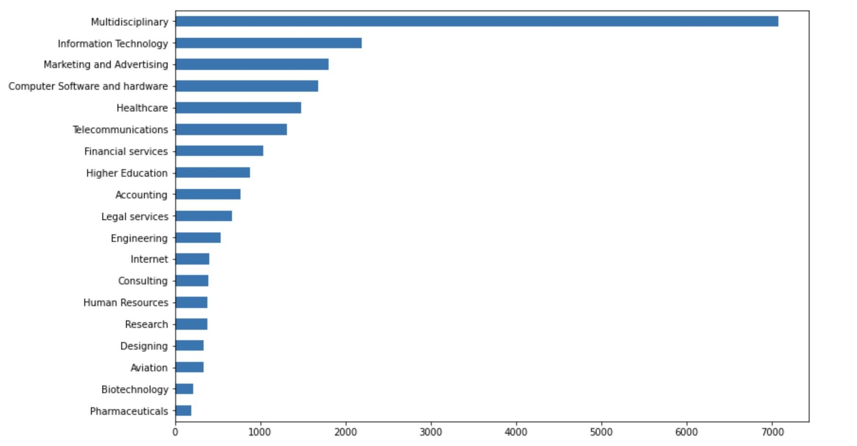
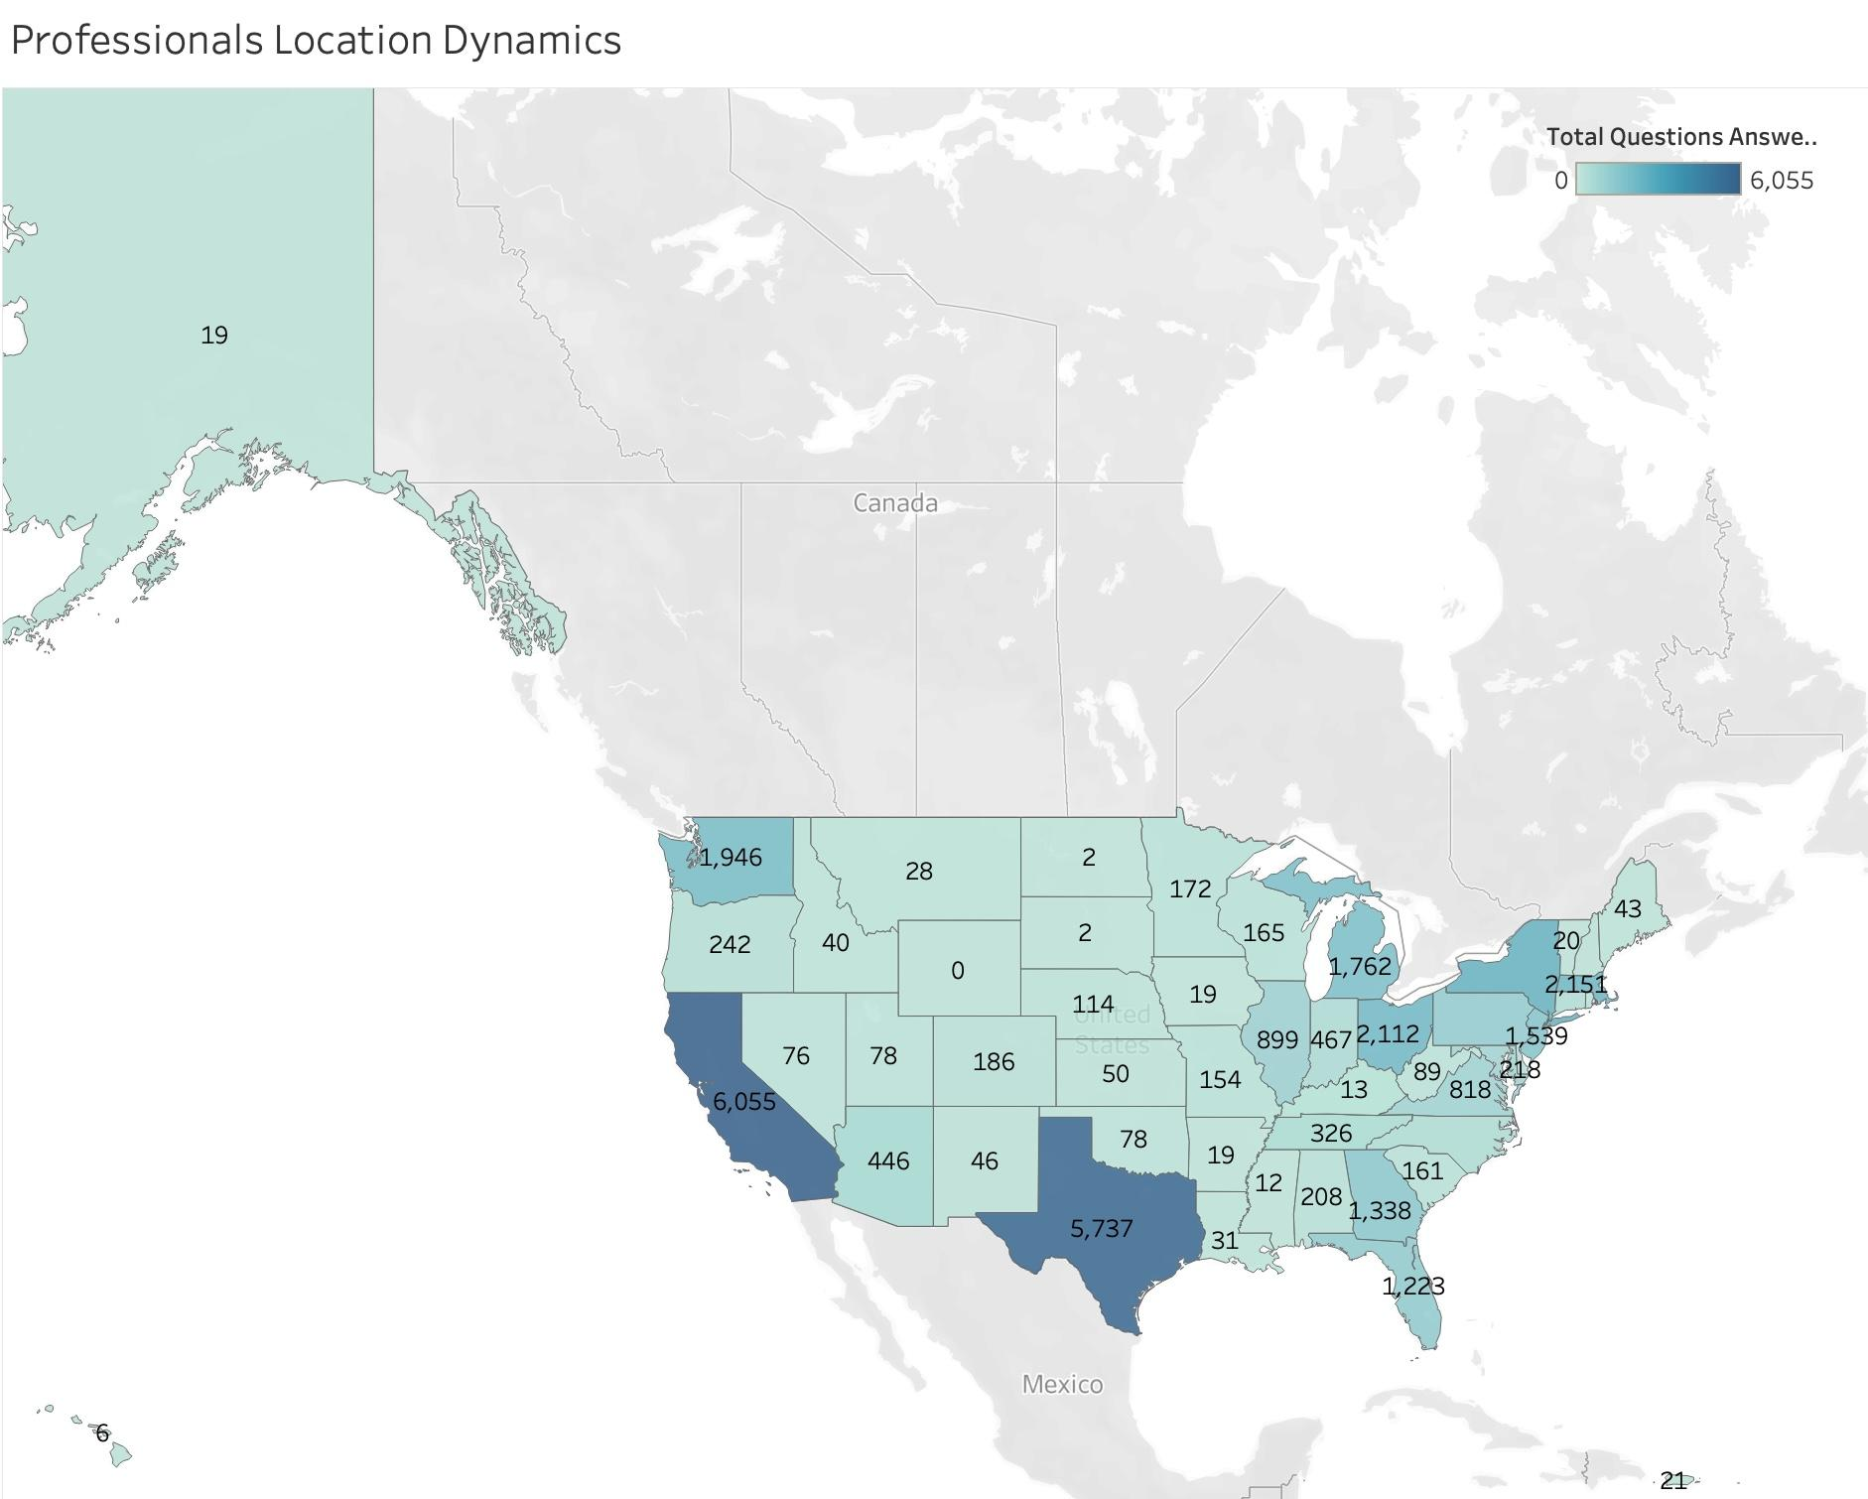
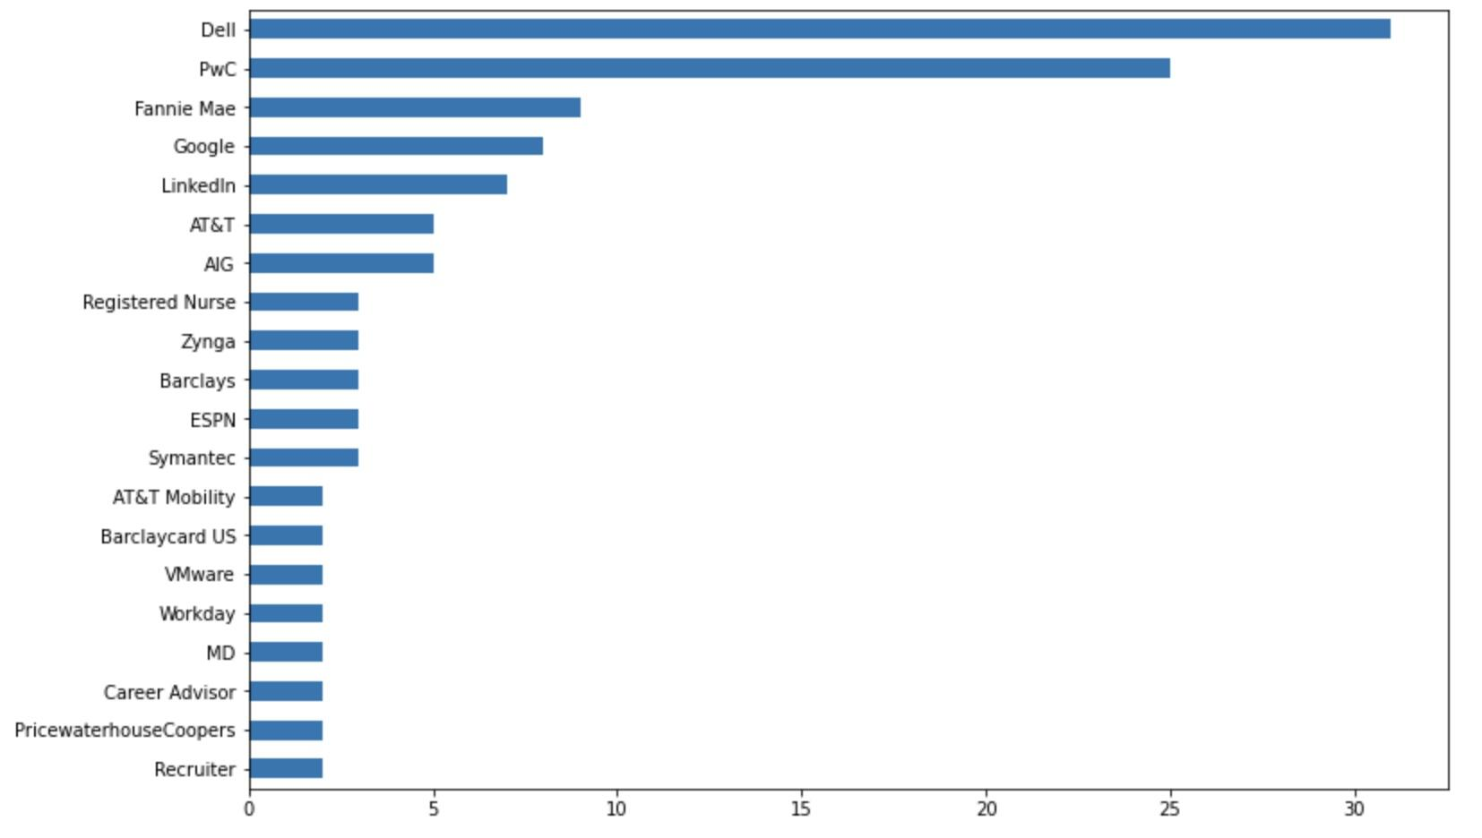
PROFESSIONALS DYNAMICS
INDUSTRY
LOCATION
COMPANY

Slide 8

PROFESSIONALS DYNAMICS
JOB POSITION WORD CLOUD OF PROFESSIONALS WHO ANSWERED MORE THAN 10 TIMES

Slide 9
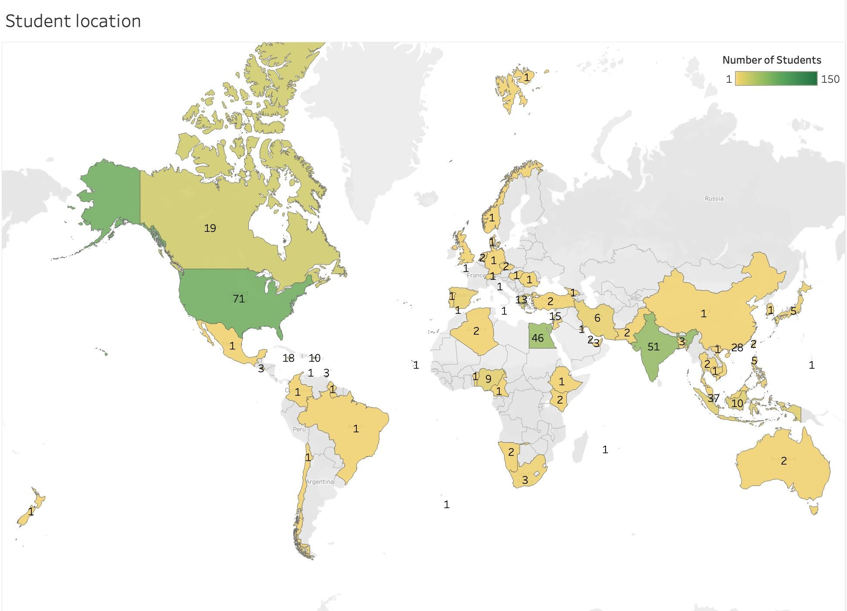
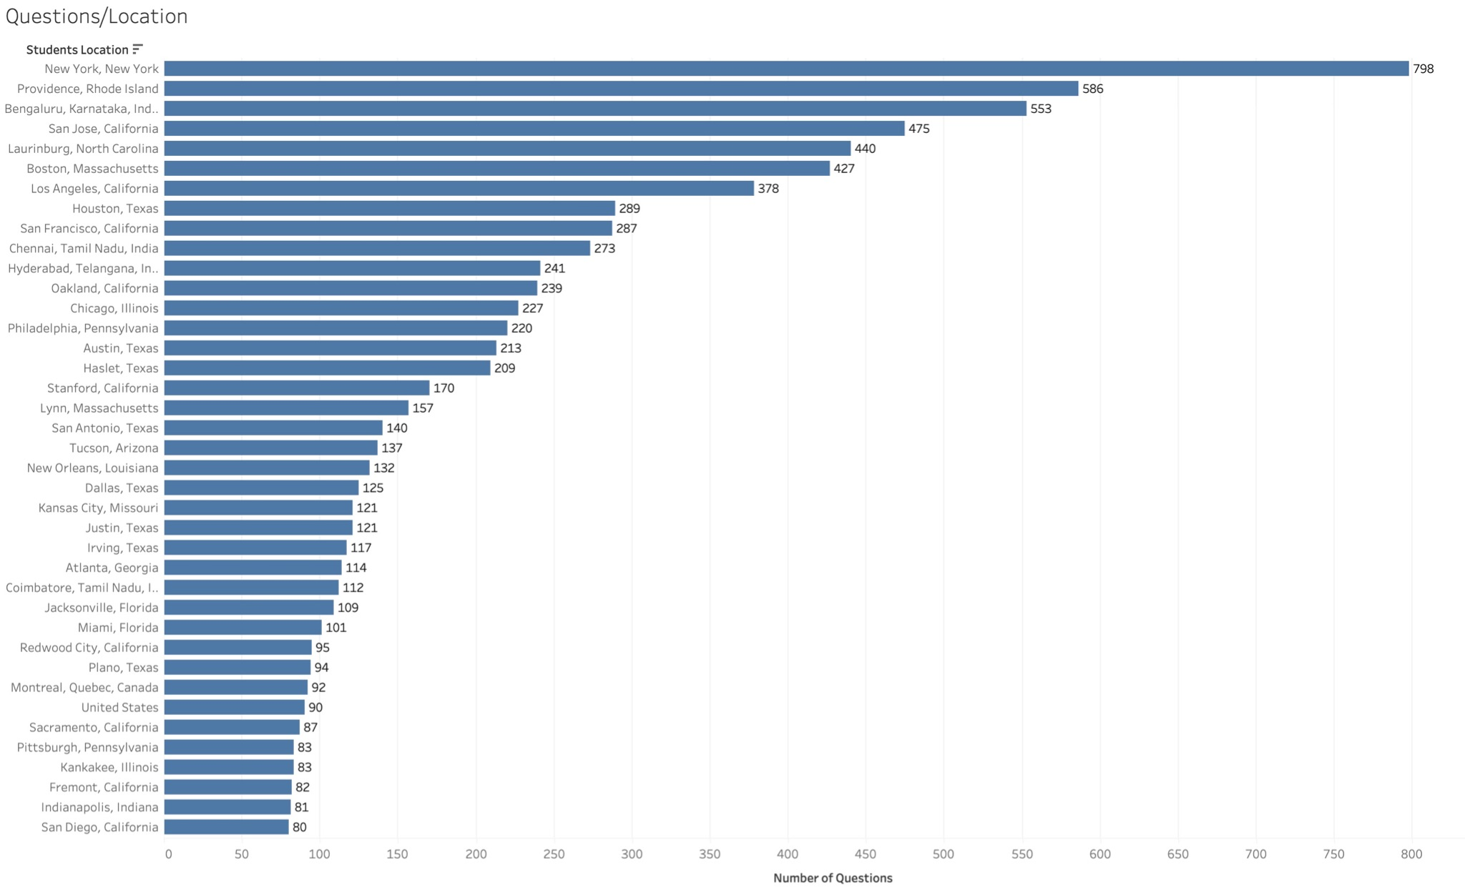
STUDENTS DYNAMICS
LOCATION
ACTIVITY LEVEL

Slide 10
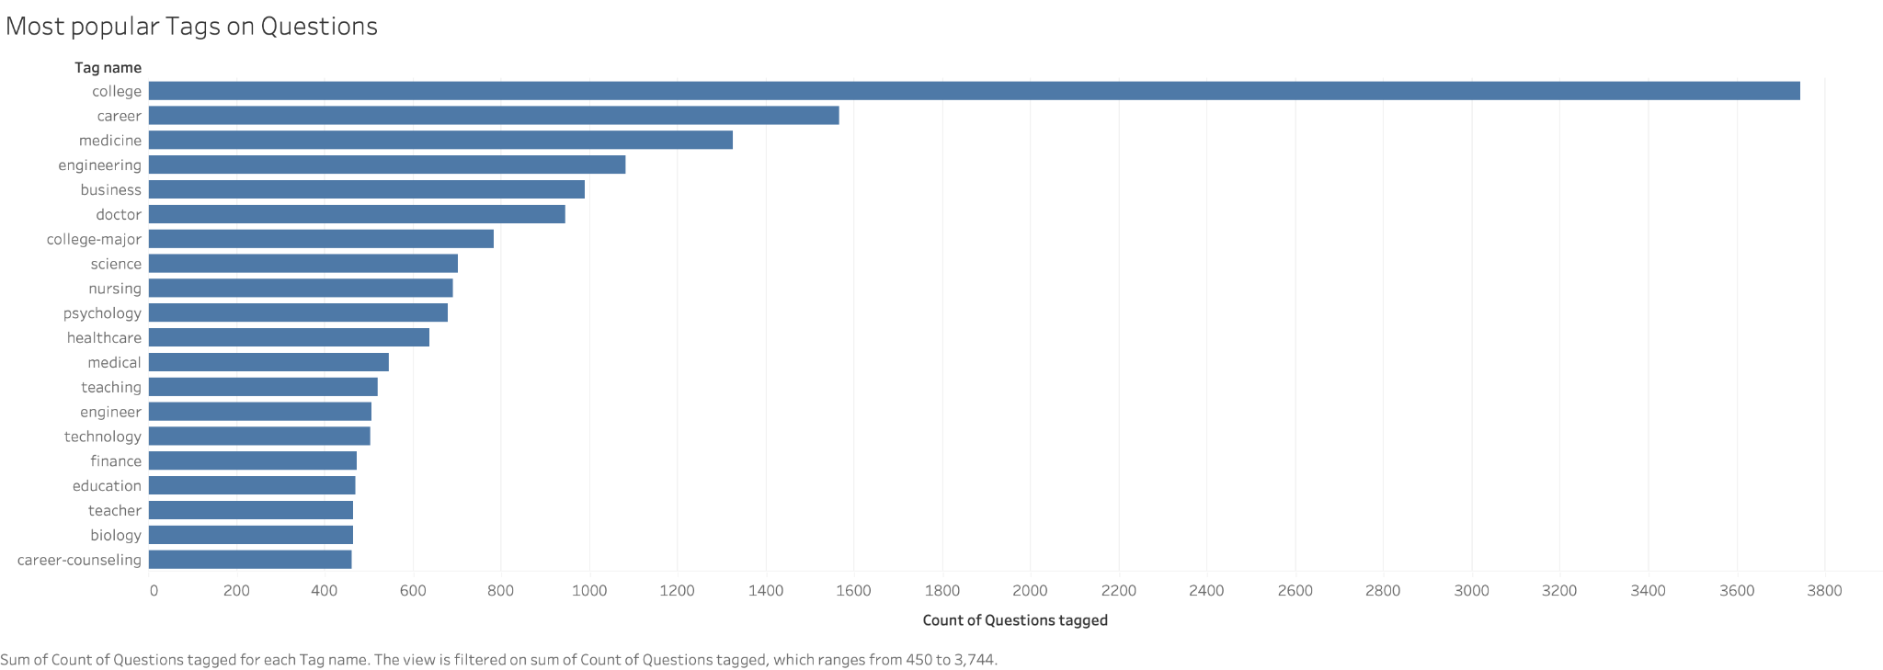
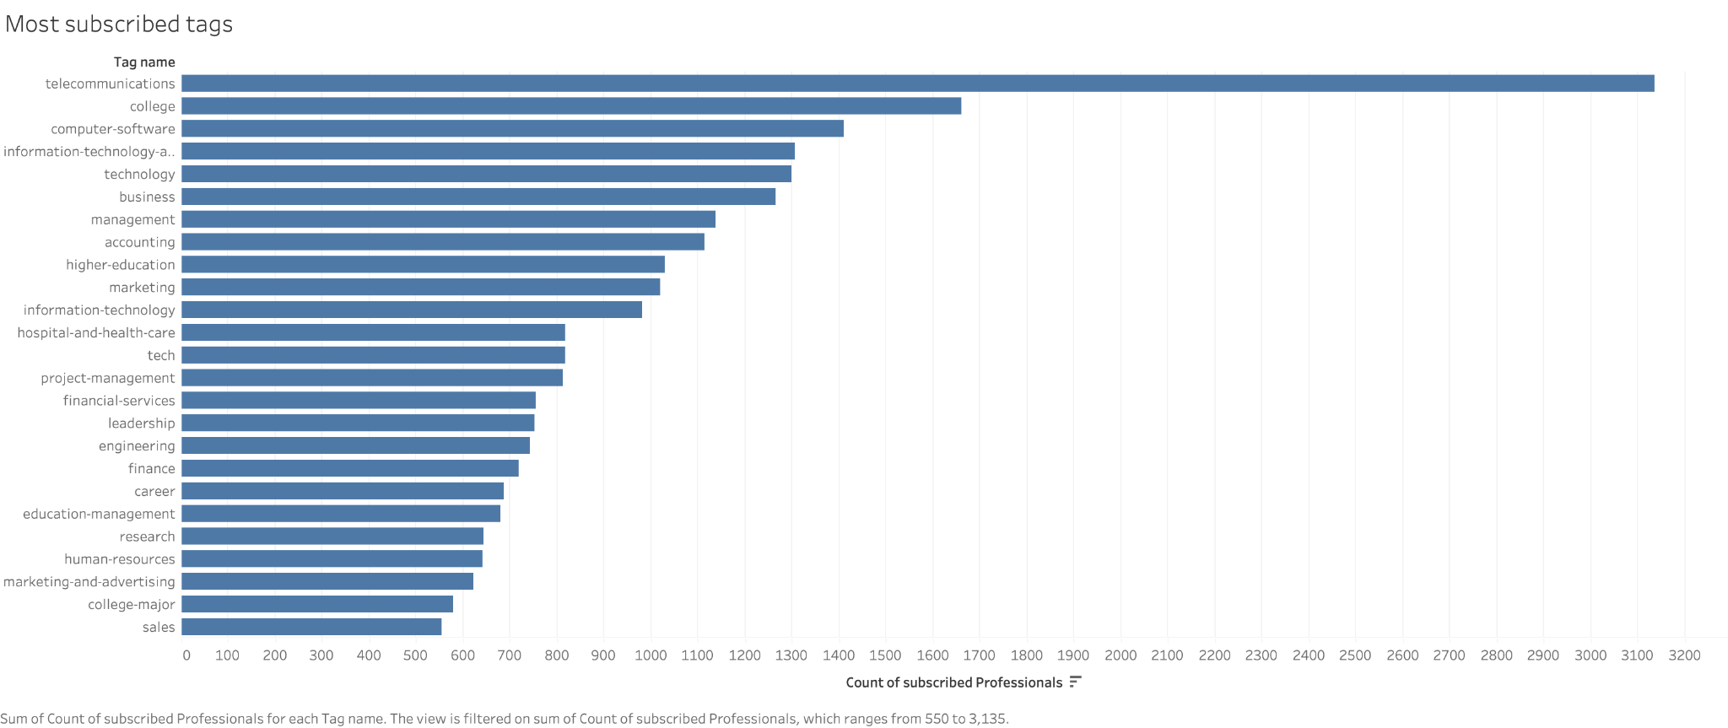
TAGS DYNAMICS
MOST POPULAR:
College, Career, Medicine, Engineering
MOST SUBSCRIBED:
Telecommunications, College, Computer Software, Information Technology

Slide 11
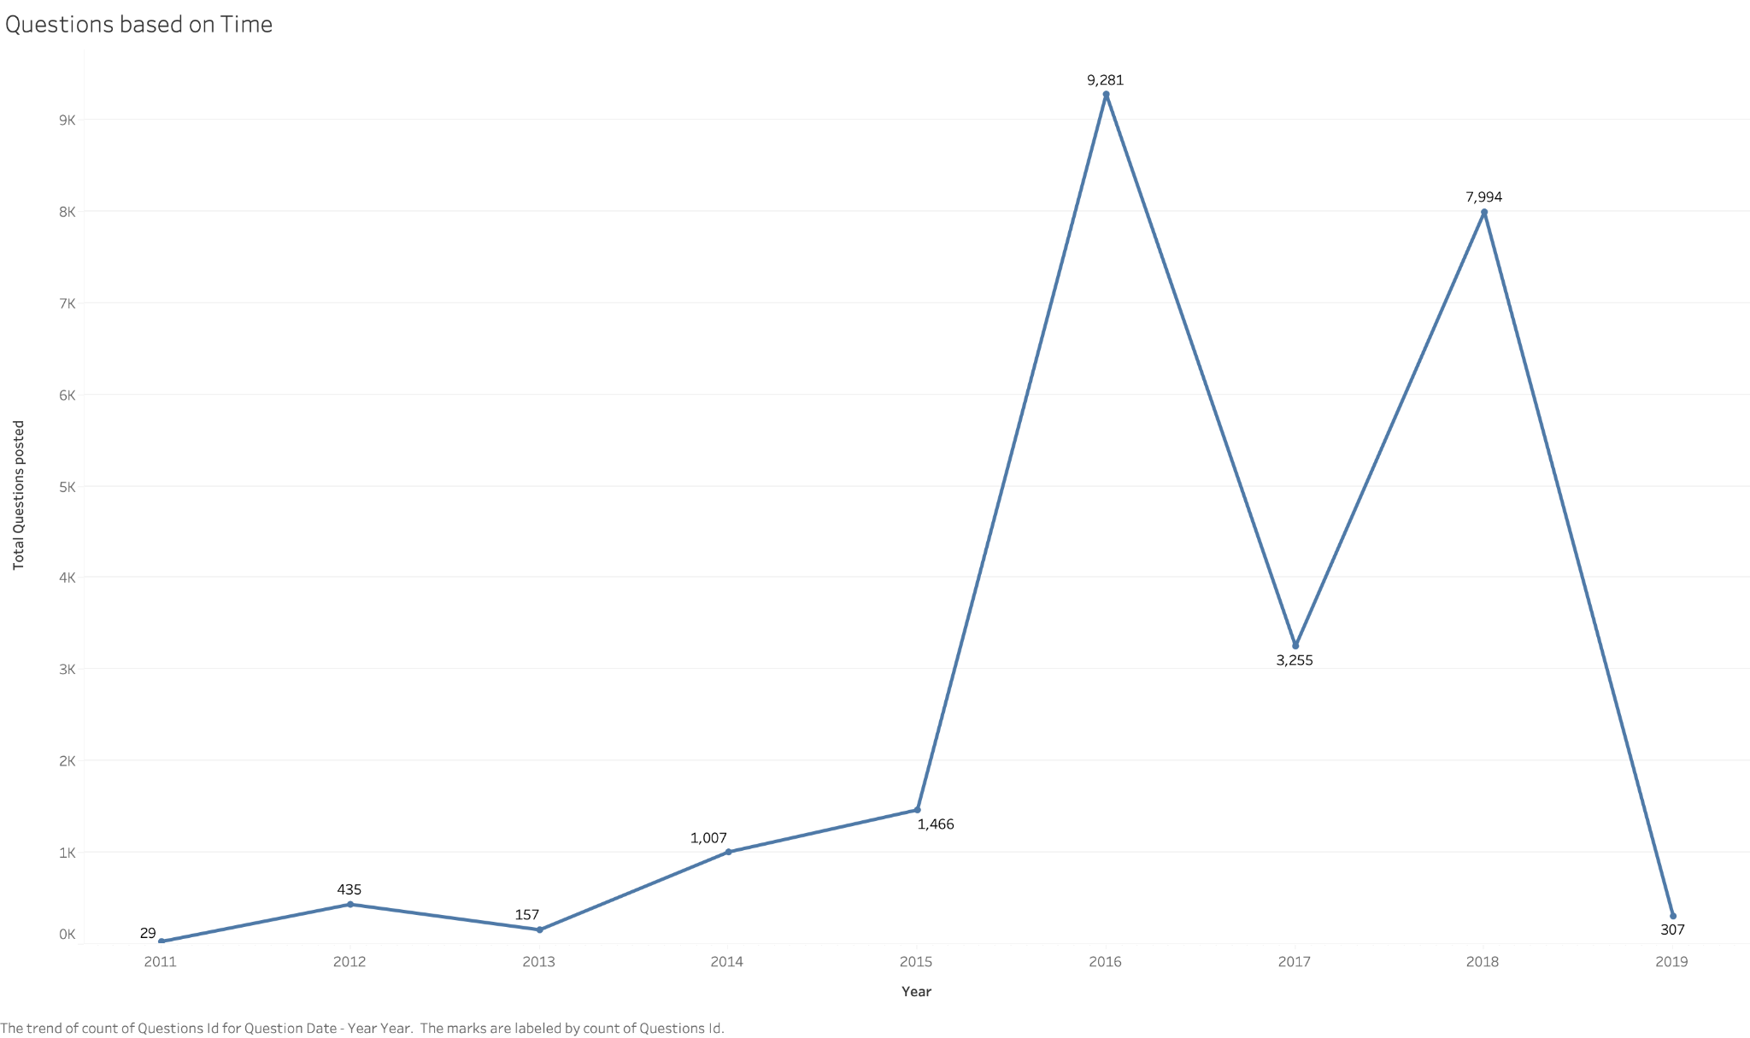
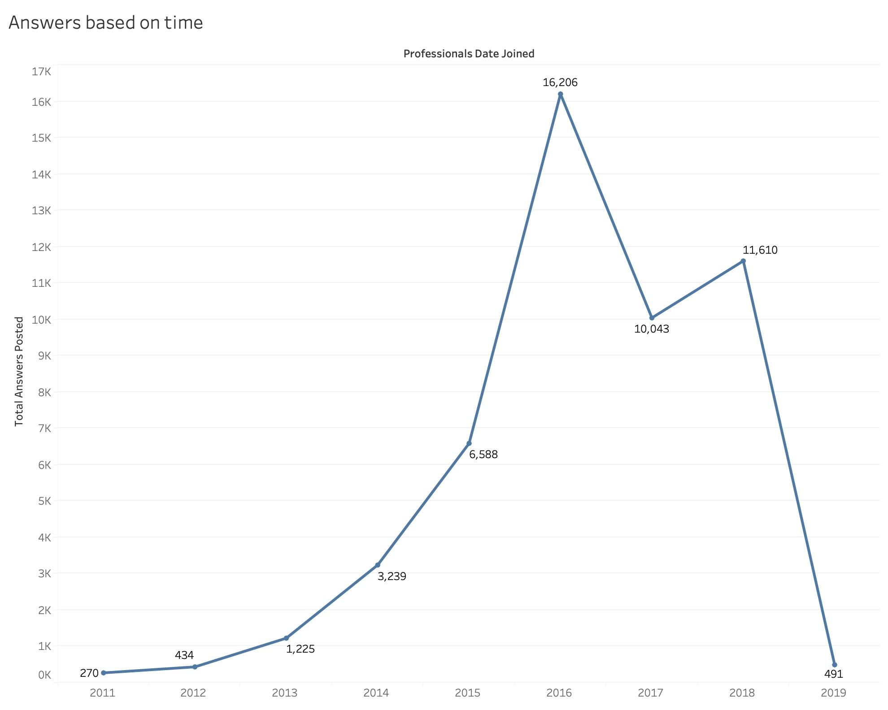
TIME DYNAMICS OF ACTIVITY LEVELS
TIME SERIES OF QUESTION FREQUENCIES
TIME SERIES OF ANSWER FREQUENCIES

Slide 12
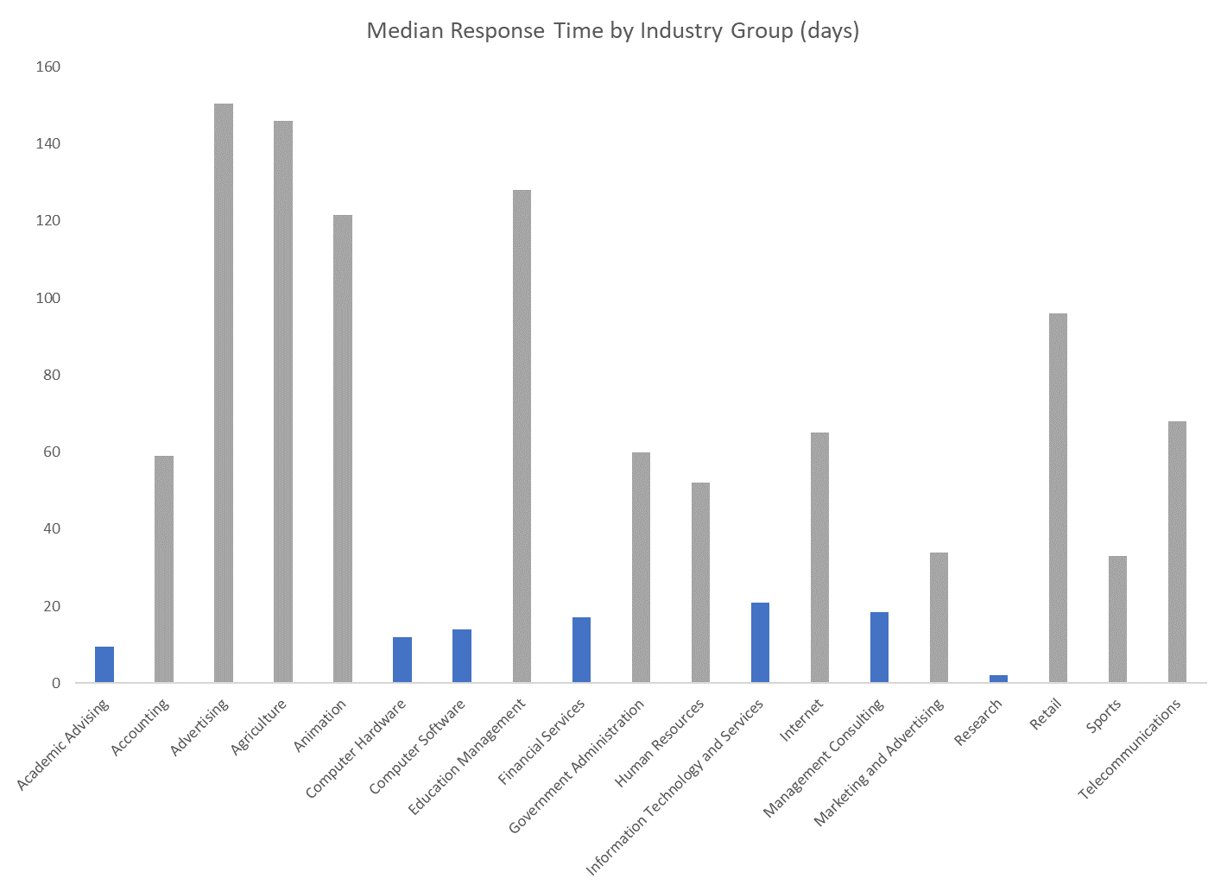
ANSWER LAG TIME
PROFESSIONALS IN THE ACADEMIC AND TECH ADVISING INDUSTRIES HAVE RELATIVELY FASTER RESPONSE TIMES

Slide 13
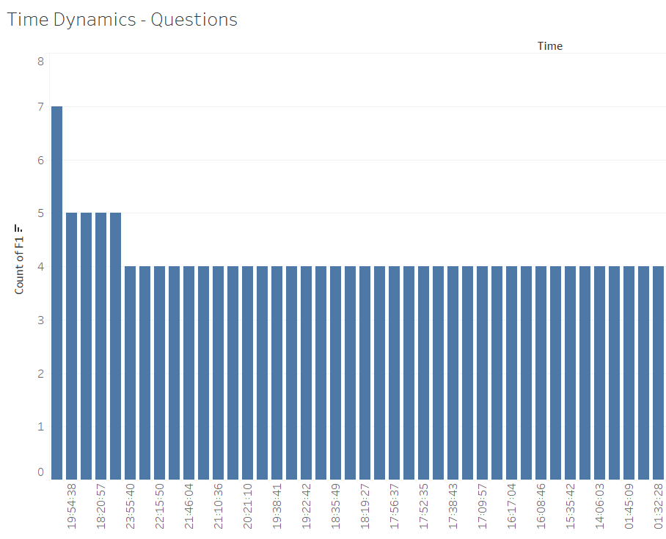
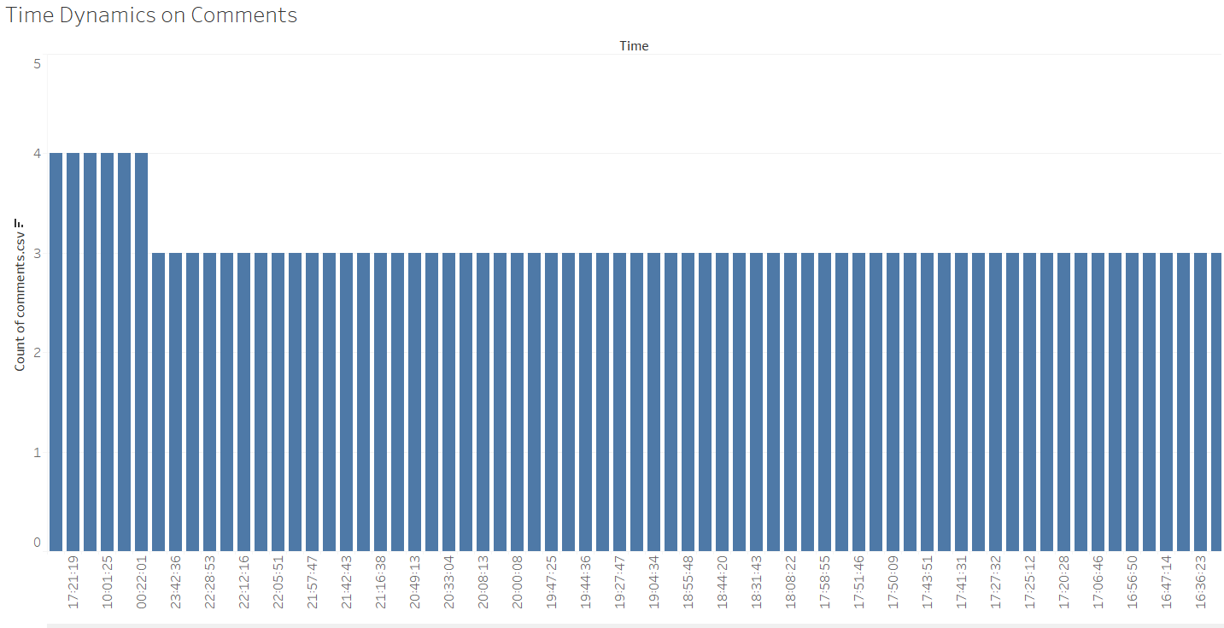
ACTIVITY LEVELS ON QUESTIONS & COMMENTS
MOST QUESTIONS ARE POSTED AFTER 2PM
MOST COMMENTS ARE POSTED AFTER 4PM
TIME FRAME FOR QUESTIONS POSTED
TIME FRAME FOR COMMENTS POSTED

Slide 14


TEXT DYNAMICS OF QUESTIONS & ANSWERS

Slide 15
MODELING
Different Modeling Techniques were used to explore trends and perform Predictive Modeling
Languages used: R and Python

Slide 16
MODELING
CLUSTERING
TEXT ANALYSIS
REGRESSION
DECISION TREES
K-Means clustering for tags and professionals’ industry
Sentiment Analysis & Topic Modeling (LDA) of questions and answers
Logistic & Linear Regression on time-to-response and 24 Hour reply
Decision Regression Trees to predict question & answer scores

Slide 17
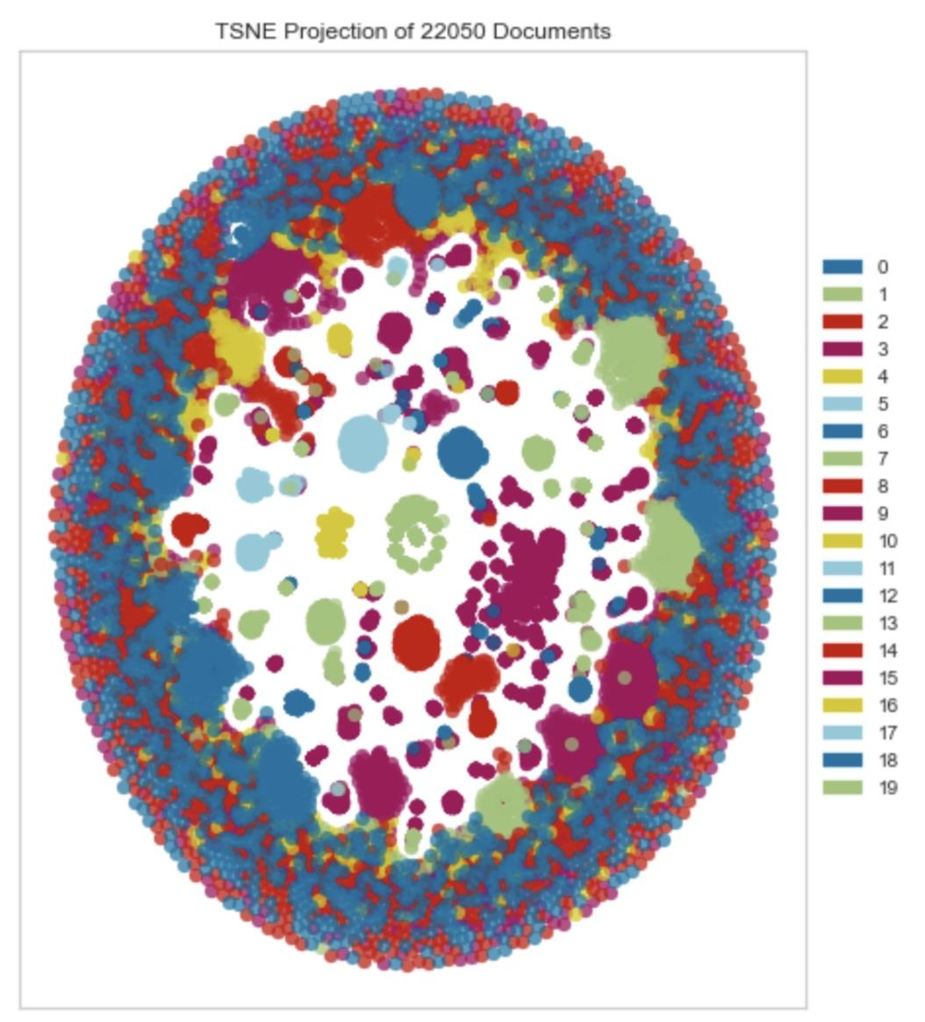
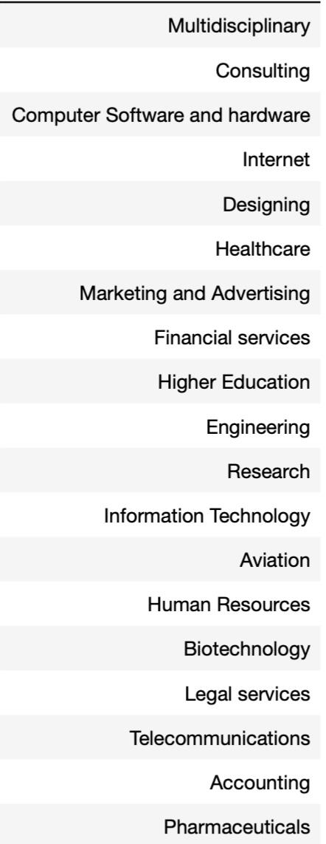
PROFESSIONAL INDUSTRY CLUSTER ANALYSIS

Slide 18
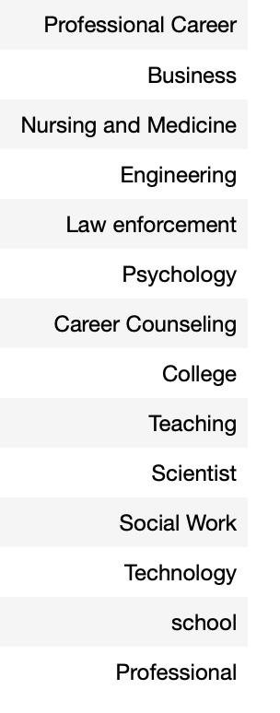
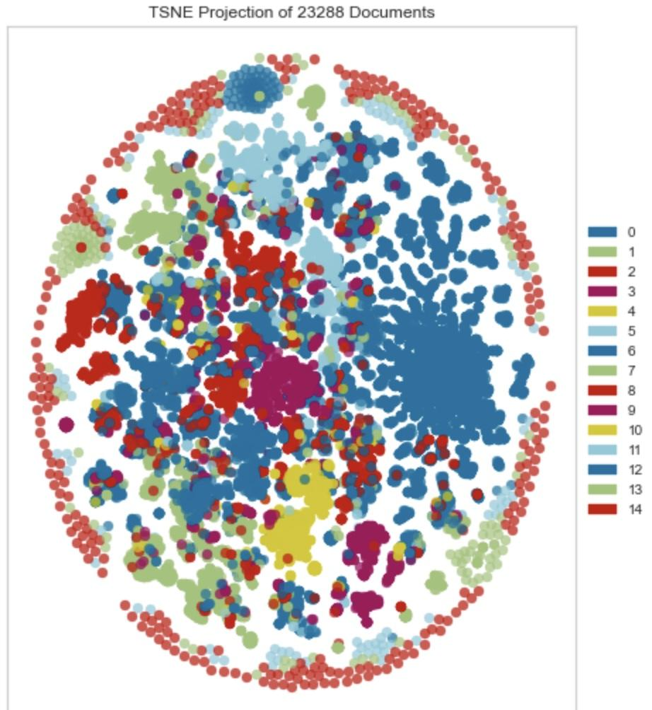
QUESTION TAGS
CLUSTER ANALYSIS

Slide 19
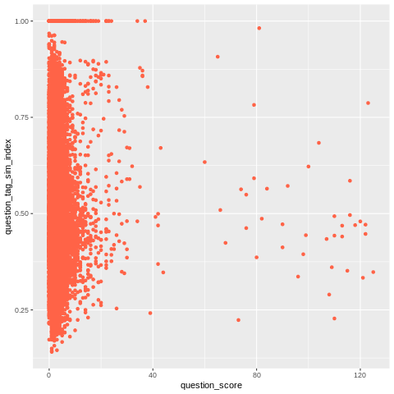
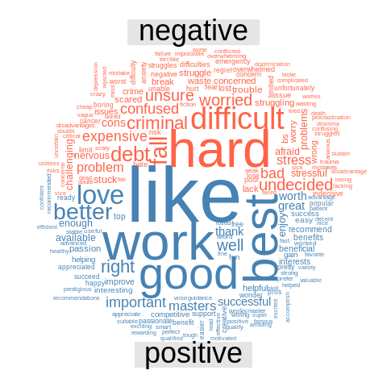
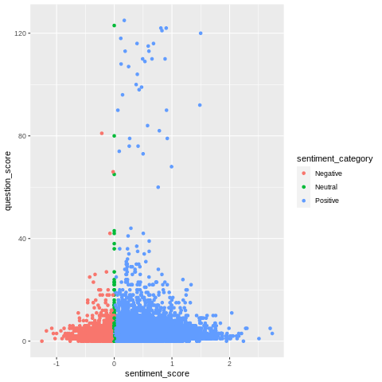
QUESTIONS SENTIMENT ANALYSIS
NO STRONG CORRELATION BETWEEN QUESTION TEXT AND TAGS SIMILARITY INDEX
SOME MODERATELY POSITIVE QUESTIONS TEND TO BE SCORED HIGHER

Slide 20
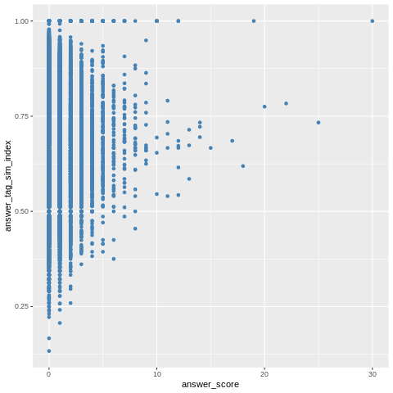

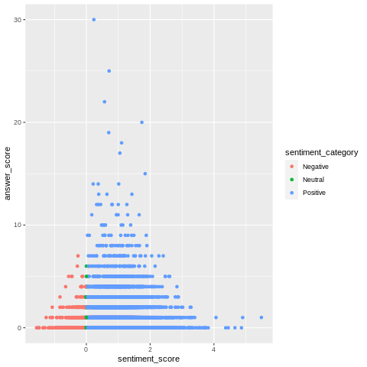
ANSWERS SENTIMENT ANALYSIS
NO STRONG CORRELATION BETWEEN ANSWER BODY AND TAGS SIMILARITY INDEX
SOME MODERATELY POSITIVE ANSWERS TEND TO BE SCORED HIGHER

Slide 21
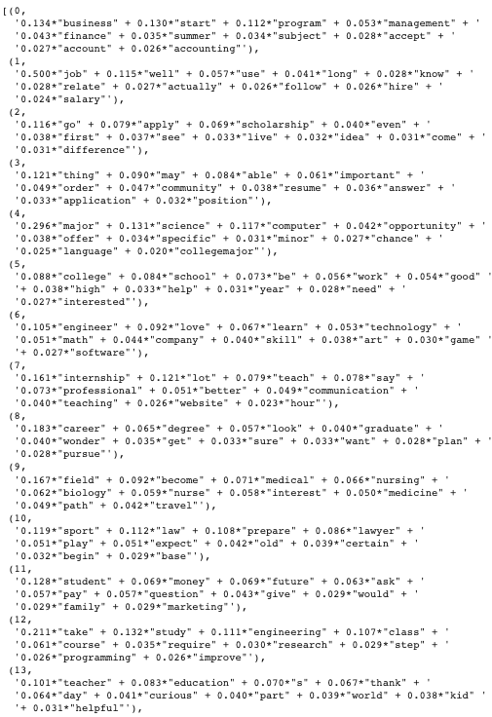
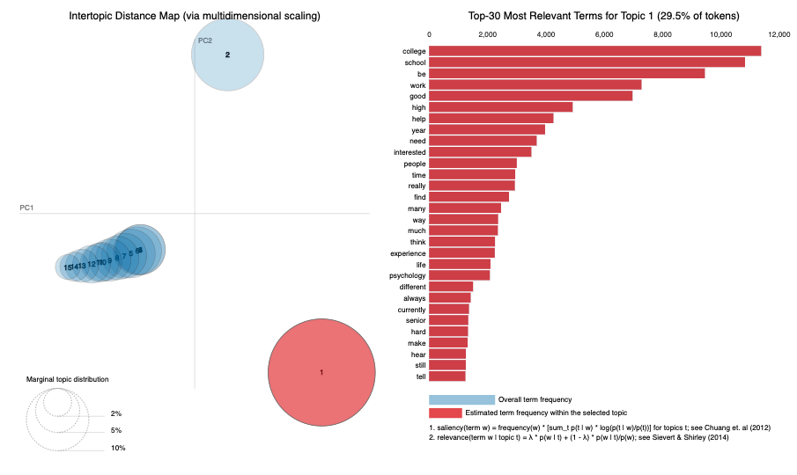
QUESTIONS TOPIC MODELING
15 TOPICS

Slide 22
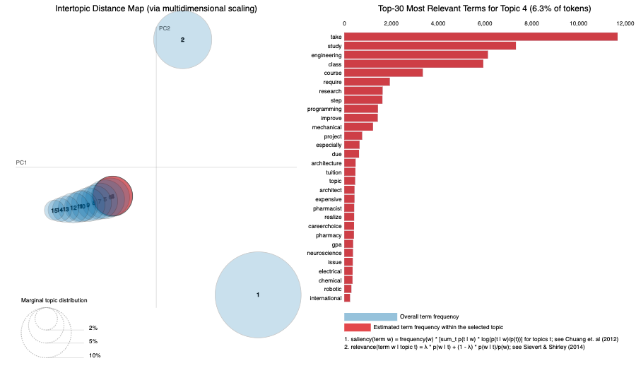
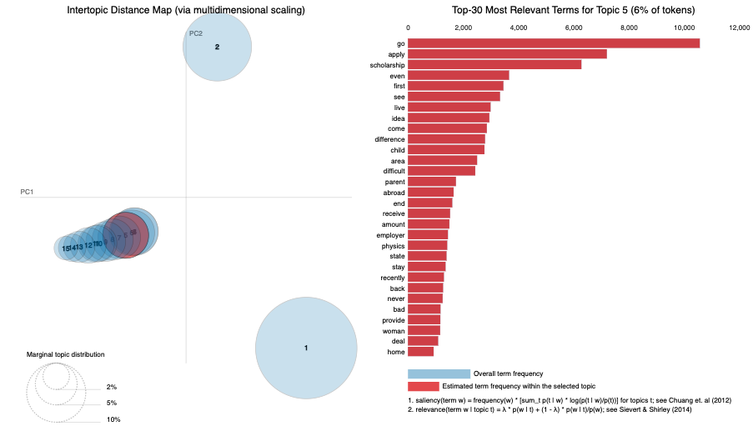
QUESTIONS TOPIC MODELING
TOPIC 4
COURSE OF STUDY
TOPIC 5
SCHOLARSHIPS

Slide 23
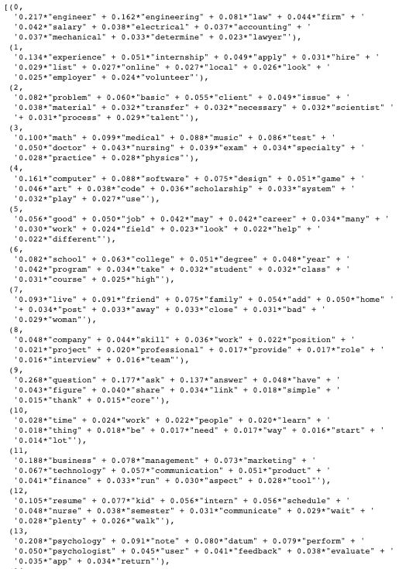
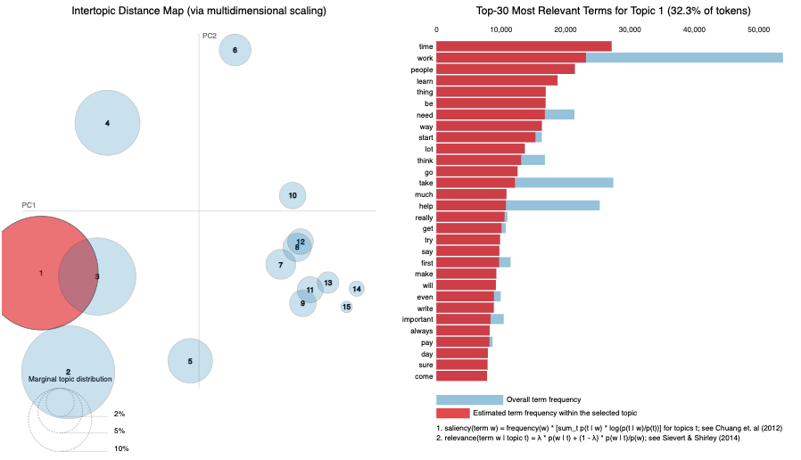
ANSWERS TOPIC MODELING
15 TOPICS

Slide 24
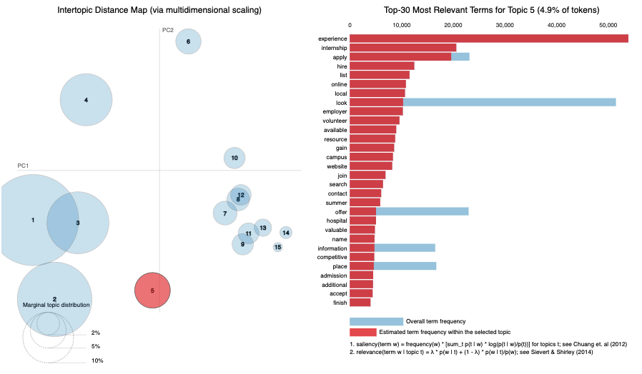
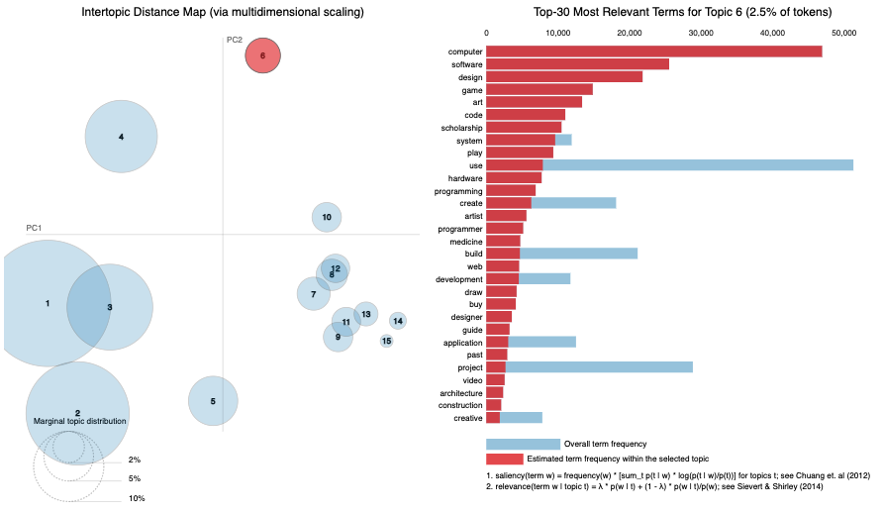
ANSWERS TOPIC MODELING
TOPIC 5
SUMMER INTERNSHIPS
TOPIC 6
SOFTWARE SKILLS

Slide 25
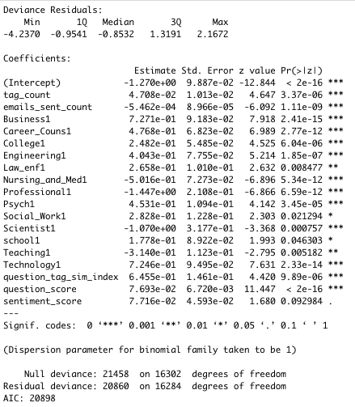
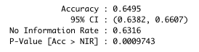
LOGISTIC REGRESSION OF QUESTIONS ANSWERED IN 24 HOURS
Dependent variable: binary variable
1= question was answered within 24 hours
0= unanswered or answered after 24 hours
*Omitted baseline industry is professional career
Question topics most likely to be answered within 24 hours:
Business, technology, career counselling, engineering
Question topics least likely to be answered within 24 hours: Professional, scientist, nursing and medicine, teaching

Slide 26
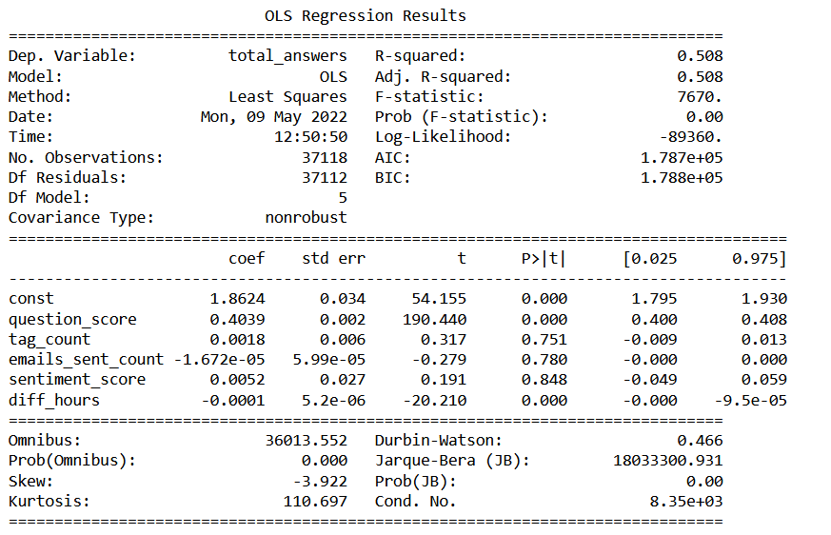
LINEAR REGRESSION OF QUESTIONS ANSWERED AFTER EMAIL NOTIFICATION IS SENT
Predicting what factors contribute to most questions being answered -
- Even though, Question Score and Difference of time between email notification sent and first question answered contribute very less, the metrics are statistically significant when predicting dependent variable, Total_Answers.

Slide 27
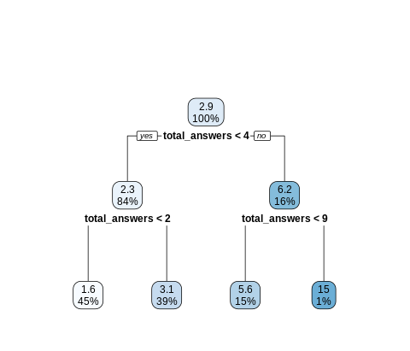
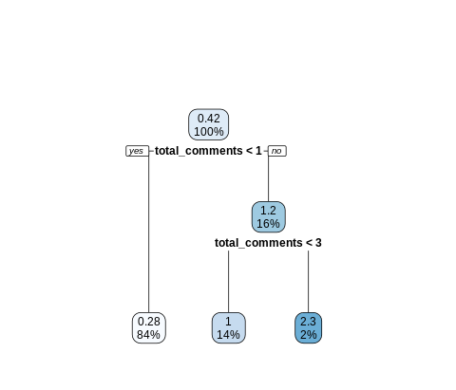
DECISION TREES FOR
QUESTION & ANSWER SCORE
FOR QUESTION SCORE
RMSE: 4.687537
FOR ANSWER SCORE
RMSE: 0.852259
METRICS USED: TOTAL ANSWERS, QUESTION SIMILARITY INDEX WITH TAGS, COUNT OF TAGS, SENTIMENT CATEGORY, TAG CATEGORY, DOMINANT TOPIC
METRICS USED: TOTAL COMMENTS, ANSWER SIMILARITY INDEX WITH TAGS, COUNT OF TAGS, SENTIMENT CATEGORY, PROFESSIONAL INDUSTRY CATEGORY, DOMINANT TOPIC

Slide 28
CONCLUSION
Scoring on questions and answers is dependent on the activity level.
Professionals who joined recently are more likely to post to answers.
Business, technology, and engineering questions are answered fastest, while science, nursing and medicine, and teaching response times and answer rates should be improved.
Questions are sent in emails after they go a certain period of time unanswered.
The number of answers received is dependent on the question score and the time taken to respond after an email is sent.

Slide 29
SUGGESTIONS
Promote the platform to other industry professionals and encourage them to subscribe to immediate notifications to have faster time-to-response for those fields.
Promote the platform in locations like India and Egypt that have a high student base to get faster response times.
Optimize the platform and have more professionals available during the high activity time.
Improve social media presence to increase the student and professional user base.

Slide 30
THANK YOU
&

